Slide 1
Dish Recommender
By: Ayush kumar

Slide 2
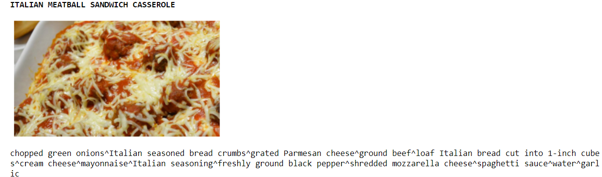
What and Why?
The reason why we are doing such project is because of the thought, “What do I eat?” I’m sure everyone here has encountered such a question. Now, usually this question is answered by either ordering in or going out to eat but, we live in a time today where going out of our own house is very cautious. Our machine has thousands of recipes and images of all kinds of dishes, the user just has to input what kind of food they would like to try (Ex. “Veg” or “Non-Veg”). The machine will then recommends few dishes in that category with their image and their recipe with the ingredients for you to make. Furthermore, our machine will include the ratings of customers that have tried the dish.This machine can be used in place of scrolling and trying to find a great dish. If you want to know more about the dishes nutrition, we have included the calories, carbs, and etc. The machine will provide all of the details required about understanding how to make your dish. When it will be more perfected it will be used in restaurant applications

Slide 3
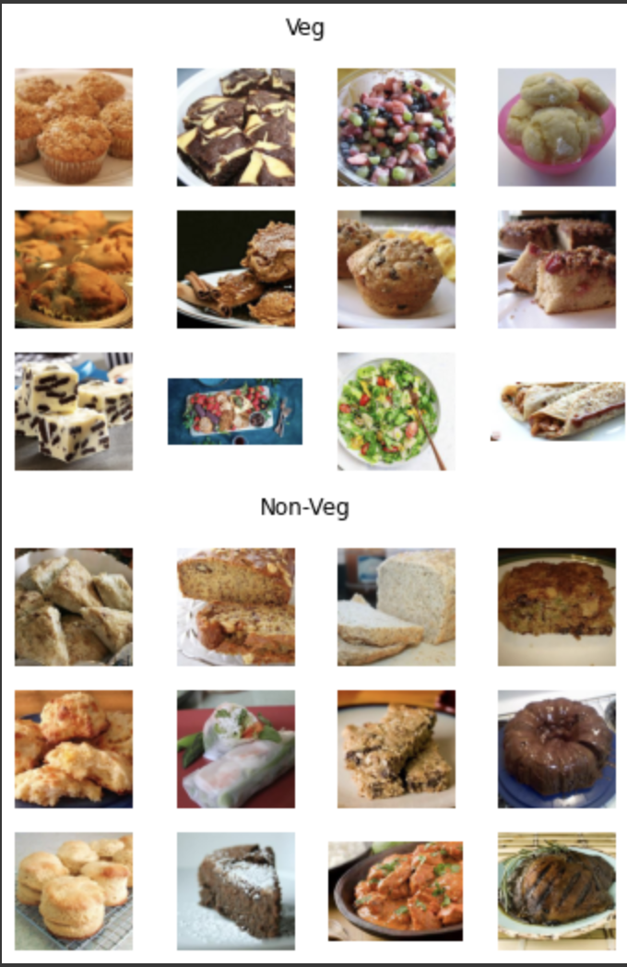
How?
The Dish Recommender works using content based filtering. Content based filtering can also be known as a recommendation system that uses item features to recommend similar items to what the user likes based on their actions or feedback. Similarly, Dish Recommender has taken thousands of recipes with content (i.e. Carbs, nutrients, etc.) and classified them into different categories. This way any of the dishes in that category will be recommended to the user, the way this is done is through cosine similarity where we are getting values from 0-1 to classify the dishes through their corresponding traits. Furthermore, the machine uses a image classification system to sort different dishes based on their features. Image Classification is the task of assigning an input image, one label from a fixed set of categories. We have classified all of our images by providing an input image with a label and asked the machine to classify the rest of the images the same way. We have categorized the images by “Veg” or “Non-Veg” so that the user can narrow down their choices from 10,000 recipes to a moderate amount.

Slide 4
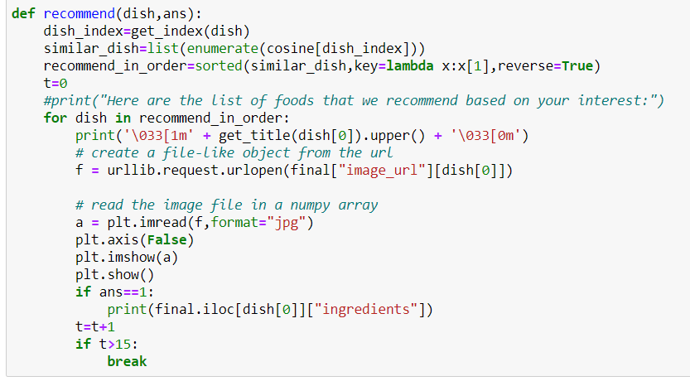
Code for Dish Recommender
Here we recommended the dishes to our users by finding similar dishes using cosine similarity then sort the dishes through the cosine values. Now, we show our results by bolding the dish name and show the image of the dish. We also ask the user if they want the ingredients or not in the last few lines and break the loop when it reaches 15 dishes.

Slide 5
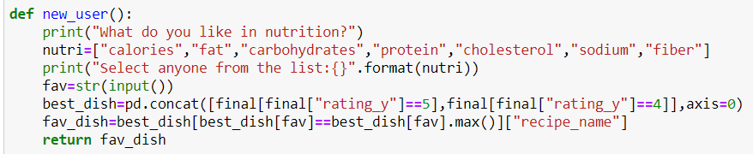
This is the process for a new user. Here we are finding what dish the user likes the most. Then we are concatenating the rating 5 and rating 4. Following that we are then asking what the user is focusing on calories, fat, carbohydrates etc. and getting the dish that has the max of that and outputting it from our function.

Slide 6
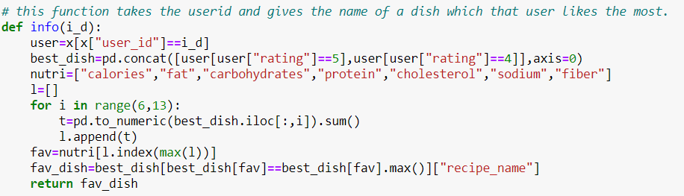
This function is used for the old user.
First, we are taking the user id. Next, we are taking the dishes with user rating 4 & 5 for that specific user. Following that we find the dish that has either the max calories, fat, carbohydrates etc. And after finding the best nutrition for that user we find which dish has the maximum value for that nutrition.
And that dish is taken as fav_dish.

Slide 7
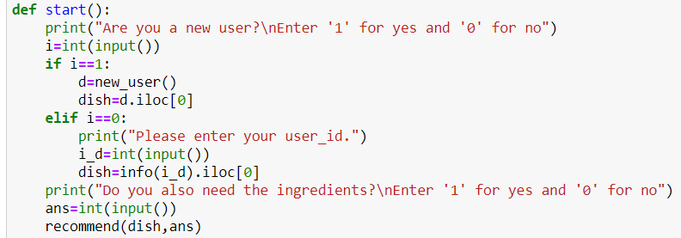
Here is where the magic happens… We first ask if the user is new if yes we revert back to the new_user() function and get their favorite dish from there. If they are already an existing user we just ask them for their userid. Following that we ask them if they want the ingredients. Lastly we use our recommend function to get similar dishes.

Slide 8
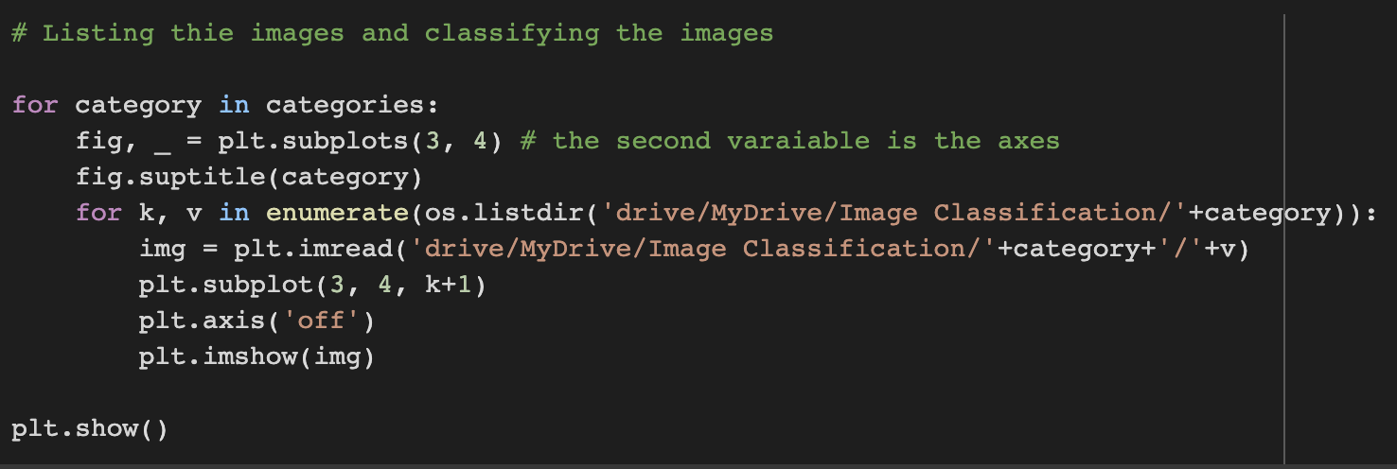
Code For the Image Classifier
Here I am categorizing each image into two categories ‘veg’ or ‘non-veg’ by reading each image through drive and giving them a place in this 3, 4 grid.

Slide 9
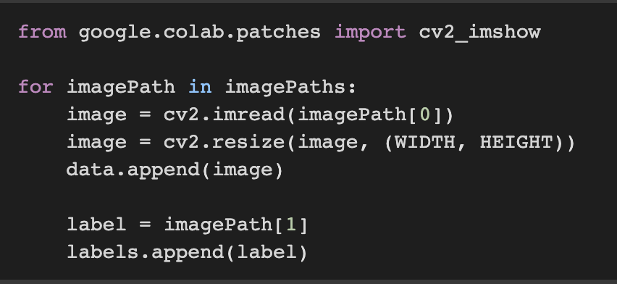
Here we are resizing each image to one size since the machine cannot understand images of different sizes. Next, we are appending each image to our data list after that we are giving it a label by going to imagePath and taking the index 1 as our label and appending it into our labels list.

Slide 10
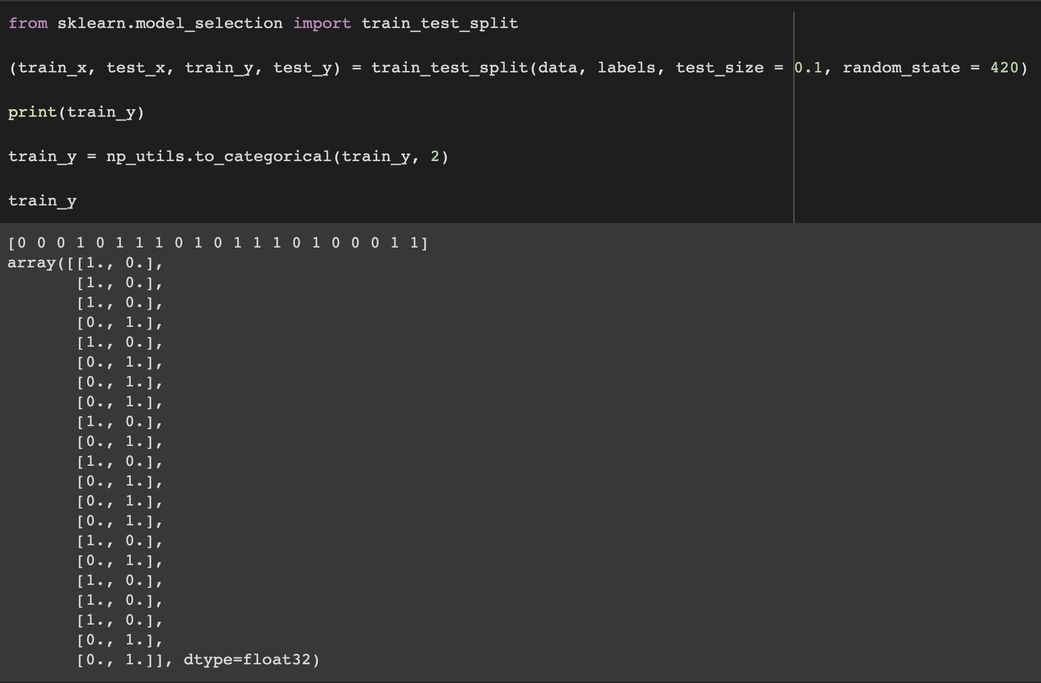
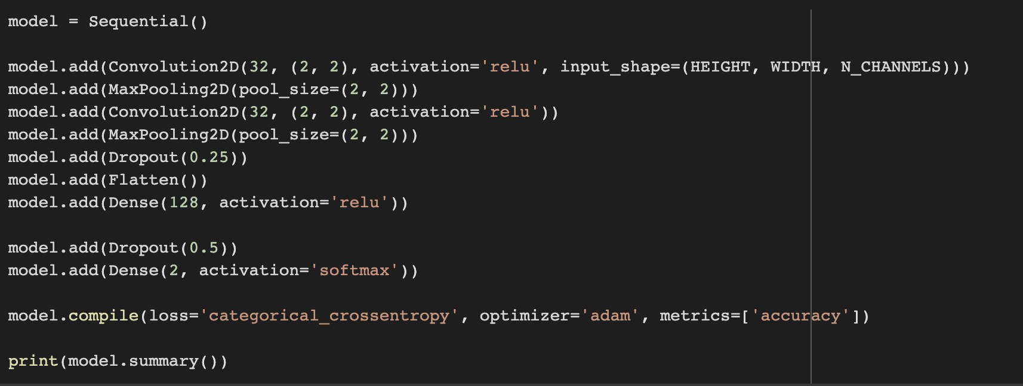
Here we are splitting our images data into train part and test part.
Here we have used sequential model and also shown the features that we are adding in the model.
And compile is used to define
the loss function, optimizer and the metrics.

Slide 11
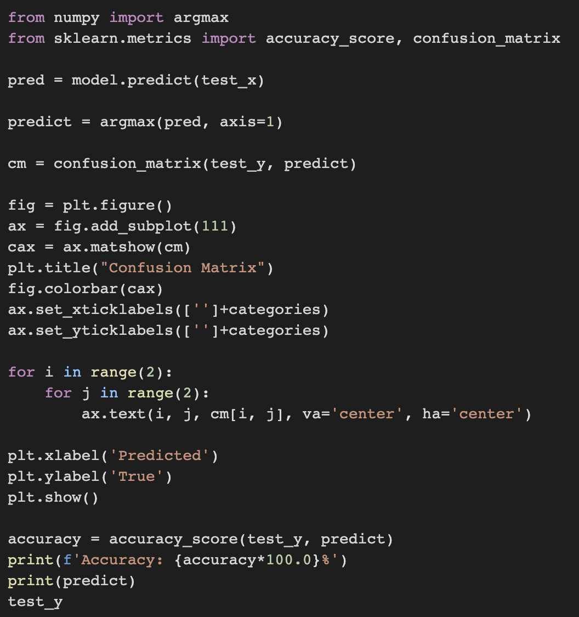
Here we are showing the output of the machine by using argmax, accuracy_score and confusion_matrix
Then we make the model predict something using our test_x. After that we create a confusion matrix and show it as an output
Finally we predict the Accuracy of the machine.

Slide 12
Thank You

